Slide 1
Car Workshop Management System
Presented by:-
Name
Prashil Aryal
Anam Rajdhami
Shivani Limbu
Krisha Duwal
Symbol Number
325142
325122
325152
325131

Slide 2
INTRODUCTION
Computer software that keeps the complete records of the vehicles in a workshop.
Built at administrative end.
Tracks all the details about the sells.
Overcomes the problems in manual recording system and saves a lot of time.
Suitable for small-large workshop.
Simple & user friendly interface.
Fully digital and easy to use.

Slide 3
OBJECTIVES
To manage the details of cars and customers.
To reduce paper work.
To retrieve information in minimum time.
To manage large number of data.
To store data permanently and systematically.

Slide 4
FEATURES
Add car
Shows all cars
Sell a car
Search a car
Modify car’s details
Delete car record
Sold cars

Slide 5
ADVANTAGES
User friendly interface.
Stores data permanently.
Highly reliable.
Keeps complete record.
Makes easier to search a car.
Saves time.

Slide 6
SYSTEM REQUIREMENTS
MINIMUM REQUIREMENTS
Hardware
PC with Pentium II Processor
32MB of RAM
Black and white monitor
Hard disk with at least 20MB of free space
Software
OS Windows (Windows XP)
RECOMMENDED REQUIREMENTS
Hardware
PC with i3 Processor
100MB of RAM
LCD Monitor
Hard disk with at least 100MB of space
Software
OS Windows (Windows 7)

Slide 7
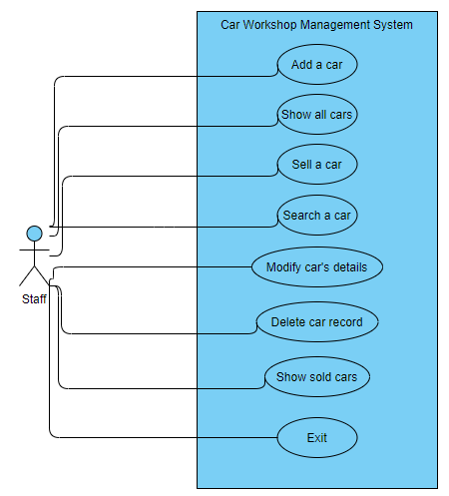
USE CASE DIAGRAM

Slide 8
SCOPES AND LIMITATIONS
Scopes
This software can be use in any workshop that sells car.
Limitations
Although we have tried our best to create a functional and user friendly software, due to the time constraints of the project, there are still a few gaping inconsistencies in it, and some features we had planned for but couldn’t include.
There is no feature to show how many cars are sold.
Needed human resource with little knowledge of computer to operate the system.
The date and time when the car was sold is not recorded.

Slide 9
ALGORITHM
Menu
Step 1: START
Step 2: display menu
1. Adding record
2. Show all cars
3. sell a car
4. search a car
5. modify car’s record
6. delete a record
7. sold cars
8. exit
Step 3: ask user’s choice
Step 4: use switch case
case 1, run function to add record
case 2, run function to display all cars
case 3, run function to sell a car
case 4, run function to search a car
case 5, run function to modify car’s details
case 6, run function to delete car’s record
case 7, run function to display sold cars
case 8, exit the program
Step 5: END

Slide 10
Add a car
Step 1: START
Step 2: open .txt file containing all the record in append mode
Step 3: check presence of file
Is file found?
If no, exit the program
If yes, let the program execute further
Step 4: ask input from user
Step 5: store the record in the file
Step 6: ask user if he wants to add more record?
If yes, goto step 4
If no, close the .txt file
Step 7: END

Slide 11
Display all cars
Step 1: START
Step 2: open .txt file containing all the record in read mode
Step 3: check presence of the file
Is file found?
If no, exit the program
If yes, let the program execute further
Step 4: read record form the file
Step 5: display the record
Step 6: is it end of file?
If no, goto step 4.
If yes, close the file.
Step 7: END

Slide 12
Sell a car
Step 1: START
Step 2: run function to display all cars
Step 3: open .txt file containing records of sold cars in append mode
Step 4: check presence of file
Is the file found?
If no, exit the program
If yes, let the program execute further
Step 5: ask user for car’s code number which is to be sold
Step 6: is the car with provided code number available?
If no, goto step 5
If yes, let the program execute further
Step 7: ask for customer’s details
Step 8: store all the data in the file
Step 9: close the file
Step 10: END

Slide 13
Searching a car
Step 1: START
Step 2: open .txt file containing all the cars’ records
Step 3: check presence of the file
Is the file found?
If no, exit the program
If yes, let the program execute further
Step 4: ask user for car’s brand name which is to be searched
Step 5: read record form the file
Step 6: is the car with provide brand name available?
If no, is it end of file?
If no, goto step 5
If yes, close the file and goto step 7
If yes, display the record and check if it is end of file?
If no, goto step 5
If yes, close the file and goto step 7
Step 7: END

Slide 14
Modifying car’s record
Step 1: START
Step 2: open .txt file containing all the cars’ records
open new empty .txt file in write mode
Step 3: check presence of file
Is the file found?
If no, exit the program
If yes, let the program execute further
Step 4: run function to display all the cars
Step 5: ask user for a car’s code number which needs to be modified
Step 6: read record the file containing all the cars’ records
Does the car code number match?
If no, store same old data in new .txt file and goto step 6 until end of file
If yes, ask for new data and record in new .txt file and goto step 6 until end of file
Step 7: close both files
Step 8: remove old .txt file
Rename new .txt file same as old one’s name
Step 9: END

Slide 15
Deleting car’s record
Step 1: START
Step 2: open .txt file containing all the cars’ records and also open a empty .txt file in write mode.
Step 3: check presence of file.
Is the file found?
If no, exit the program
If yes, let the program execute further
Step 4: run the function to display all the cars
Step 5: take car’s code number which is to be deleted from the user as input
Step 6: read record from the file containing all the records
Step 7: does the code match?
If yes, goto step 6 until end of file
If no, store the data in the new empty .txt file and goto step 6 until end of file
Step 8: close both files
Step 9: remove the old file containing all the records
rename the new .txt file same as old one’s name
Step 10: END

Slide 16
Conclusion and Future Enhancement
Conclusion
To sum up, we intend to provide a user-friendly platform for workshop car dealer to do their daily tasks through our software. This software provides a platform to keep record of the cars’ detail and also the record of sold cars along with customer’s details. As all the data are stored permanently in the file, it is reliable and secure.
Future Enhancement
Followings are the supposed future implementation of the project:
Option to pay cash through QR code.
Make app for clients also (for booking/buying purpose).
Make the software able to record more details of the car.
Option to add different types of vehicles.
Make more interactive user interface.

Slide 17
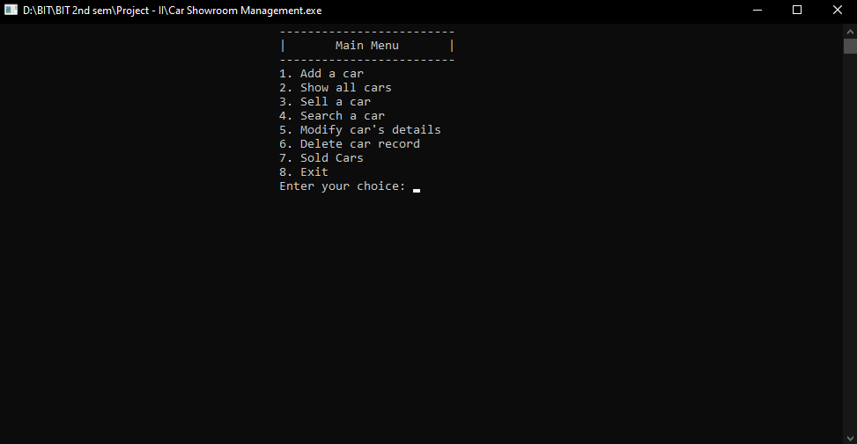
SNAPSHOTS
Menu

Slide 18
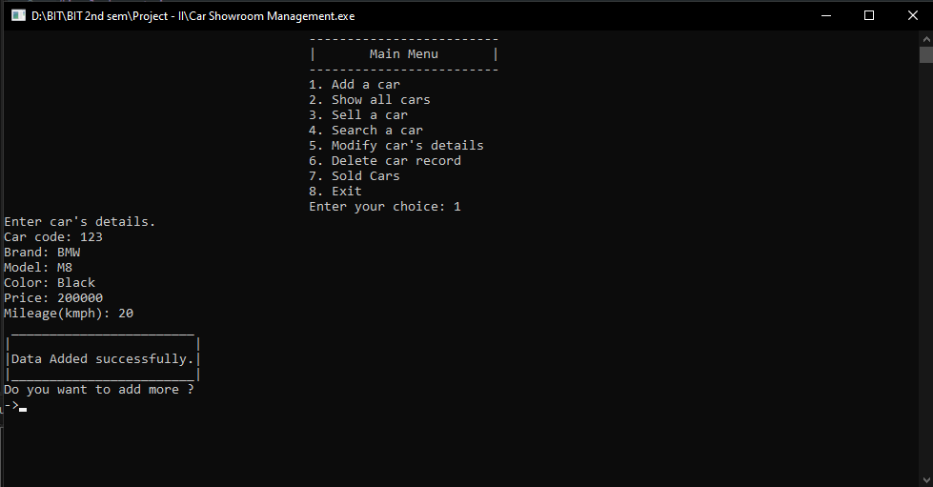
Adding a car

Slide 19
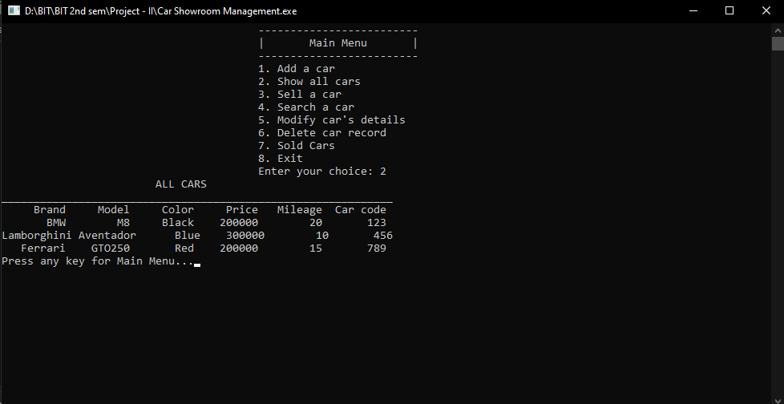
Show all cars

Slide 20
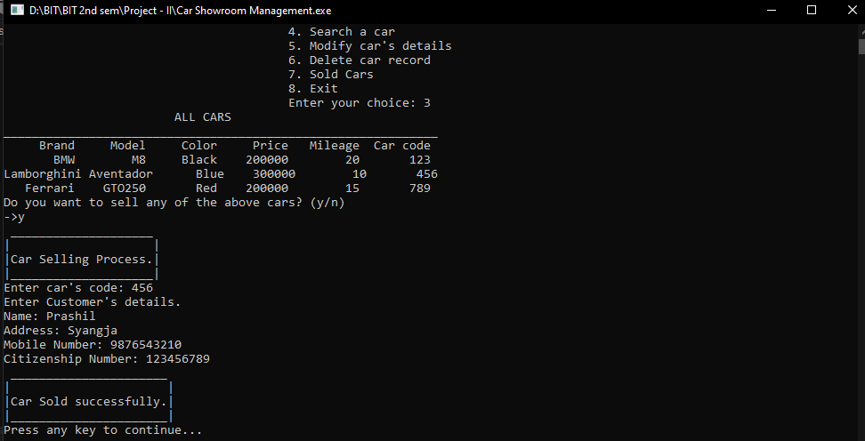
Sell a car

Slide 21
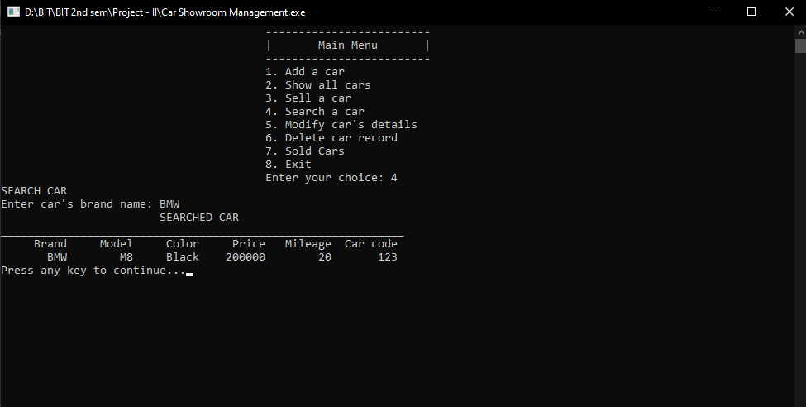
Search a car

Slide 22
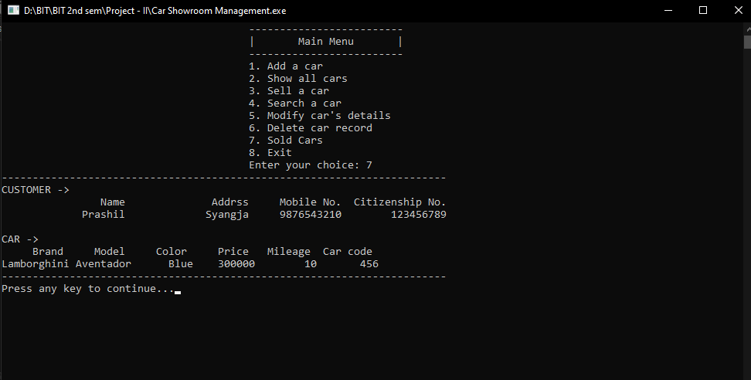
Sold cars

Slide 23
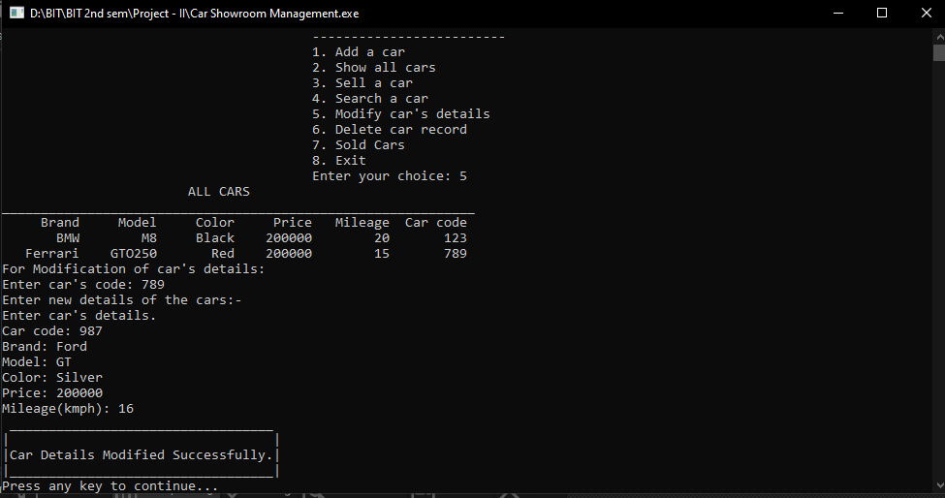
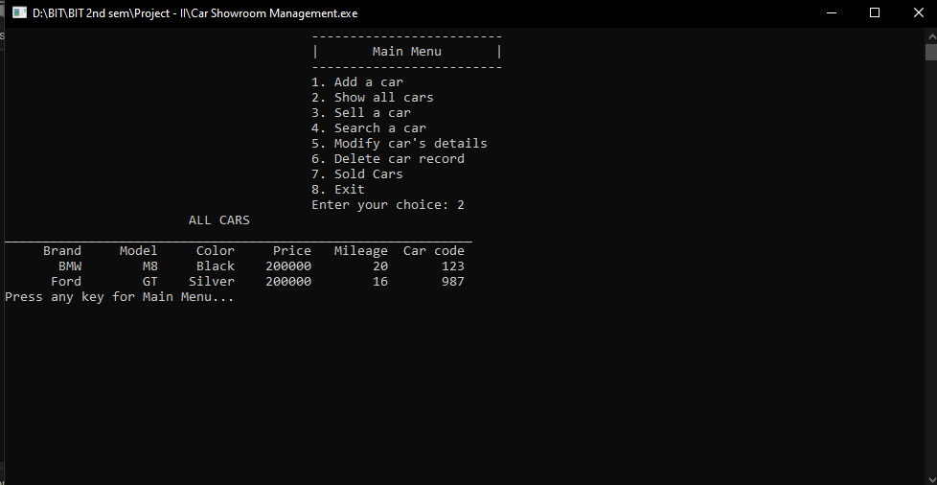
Modify car’s details
Before After

Slide 24
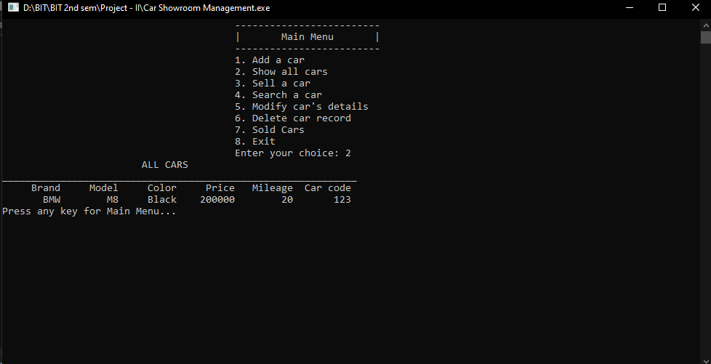
Delete car record
Before After

Slide 25
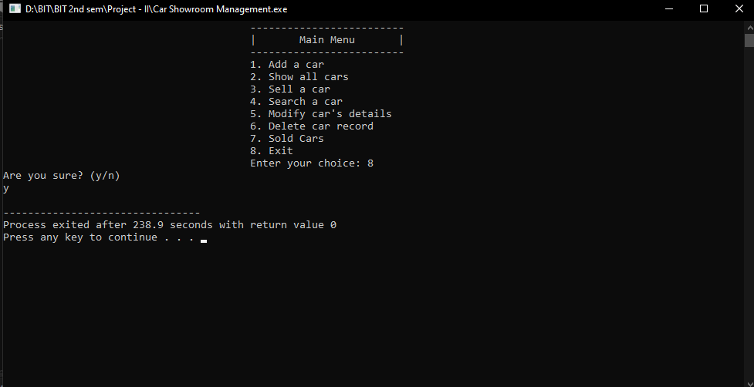
Exit

